Slide 1


FAKEFINDER
DeepFake Audio Detection&Generation

Slide 2

TEAM MEMBERS
Mark Rafat Sarkies
Andrew Ibrahim Ishac
Kirollous Hany Eshak
John Halim Hanna
Habiba Abdelghany sayed
Essam Ahmed Mahmoud

Slide 3


CONTENTS
1
What is FakeFinder?
10
Conclusion
2
Problem Statement
3
System Overview
4
Similar Apps
5
Datasets
6
Data Preparation
7
Data Preprocessing
8
Methodologies
9
Software Modules

Slide 4




1
What is FakeFinder?
TO CATCH A THIEF, YOU MUST THINK
LIKE ONE.
FakeFinder is a Deepfake Audio Detection and Generation Mobile Application that we made as a countermeasure for deepfakes especially the Audio ones because We believe that it is a serious threat to our society and can be used to manipulate people and undermine trust in our institutions. Fake Finder can help combat the spread of deepfake audio and protect people from its harmful effects.

Slide 5







2
Problem Statement
•UNDERMINE TRUST IN OUR INSTITUTIONS
•IDENTITY THEFT AND FRAUD
•MISINFORMATION AND
MANIPULATION:
•DAMAGE SOMEONE'S REPUTATION

Slide 6



System
OverView

Slide 7





3
System Overview
Filtration
Generation
Detection

Slide 8
3
System Overview
Detection
a Deep Learning Model integrated with an Android application aims to Detect whether the input audio is bonafide or Deepfake Generated
input
output
Audio
Real or Fake

Slide 9
3
System Overview
Generation
a Deep Learning Model integrated with an Android application aims to Generate a Fake Audio combining the input text with input audio sample
input
output
Audio
Fake Audio
Text

Slide 10
3
System Overview
Generation
a Deep Learning Model integrated with an Android application aims to Generate a Fake Audio combining the input text with input audio sample
input
output
Audio
Fake Audio
AUDIO

Slide 11
3
System Overview
Filtration
a Deep Learning Model integrated with an Android application aims to Emit any noise that the audio input contains to make it clean
input
output
Audio
Denoised Audio

Slide 12
Similar Apps

Slide 13




4
similar apps
Feature | FakeFinder | Lyrebird | Resemble
Platform
Voice Filtration
Deepfake Audio Generation
Fake Audio Detection
User Profiles
History of Audio Activities

Slide 14
Datasets

Slide 15



5
Detection Datasets
Asvsppof2019
Wavefake
Total recordings: Over 40 hours
Speakers: 107 (46 males, 61 females)
Dataset partition:
Training: 20 speakers (8 males, 12 females)
Development: 10 speakers (4 males, 6 females)
Dataset for audio deepfake detection
Size: Over 100K generated audio clips
Applications:
Speech recognition
Music composition

Slide 16
5
Generation Datasets
VCTK
LibriSpeech
Size: Over 40,000 utterances
Speakers: 109
Quality:
High-quality audio
Minimal background noise
Consistent recording conditions
Size: Approximately 1000 hours
Sampling rate: 16kHz
Features:
Carefully segmented
Aligned for accuracy

Slide 17
5
Filtration Datasets
TIMIT
speech-denoiser-dcunet
Number of different types of noise clips: 27
Training set size: 4620 files
Testing set size: 200 files
clean and noise for the same audio
split into train and test
Noise_Train_Input: 11600 files
clean_trainset_wav:11600 files
Noise_Test_Input:824 files
clean_testest_wav:824 files

Slide 18
Detection

Slide 19
Data
Preparation

Slide 20

6
data Preparation
ASVspoof2019
Dataset Overview
Data Structure
Training Set:
Contains both genuine and spoofed audio samples.
Validation Set:
Used for model validation during training.
Evaluation Set:
It consists of unseen data to test the model's performance.
Each audio file is labeled "genuine" or "spoof."
The dataset includes a file list with corresponding labels for easy access.

Slide 21
6
data Preparation
wavefake
Data Structure
Each audio file is "genuine" or "fake."
The dataset includes metadata files with corresponding labels.

Slide 22
Data
Preprocessing

Slide 23
7
data Preprocessing
ASVspoof2019
Wavefake
Load Audio: Use librosa.
Resample: Ensure a consistent sampling rate.
Denoise: Reduce noise.
Trim Silence: Remove silent parts.
Normalize: Use scikit-learn.
Load Audio: Use librosa.
Resample: Ensure a consistent sampling rate.
Denoise: Use noisereduce.
Trim Silence: Remove silent parts.
Normalize: Use scikit-learn.

Slide 24
Models

Slide 25
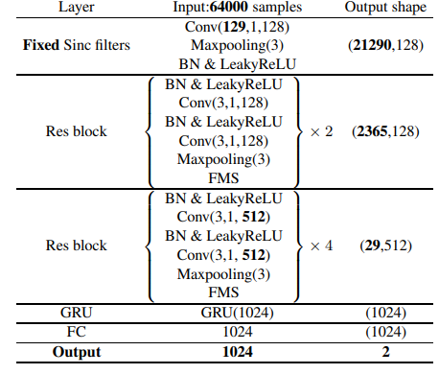
8
Methodologies
RawNet2
The model architecture consists of
convolutional and recurrent layers
for feature extraction and sequence modeling. and is designed to
process raw audio signals directly
without any preprocessing.
H. Tak, J. Patino, M. Todisco, A. Nautsch, N. Evans, and A. Larcher, “End-to-end anti-spoofing with rawnet2,” ICASSP 2021 - 2021 IEEE International Conference on Acoustics, Speech and Signal Processing (ICASSP), Jun 2021. [Online]. Available: http://dx.doi.org/10.1109/ICASSP39728.2021.9414234

Slide 26
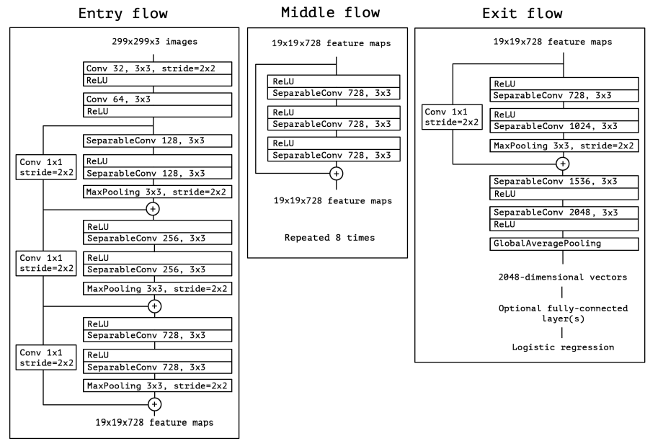
8
Methodologies
XceptionNet
The Xception model architecture is based on depthwise separable convolutions(each input channel is convolved independently with a separate filter)
consisting of multiple layers of depthwise separable convolutions followed by pointwise convolutions(a 1x1 convolution is applied to combine the output channels).
This design allows for efficient feature extraction and parameter reduction, leading to improved performance in tasks like audio deepfake detection
- F. Chollet, “Xception: Deep learning with depthwise separable convolutions,” in Proceedings of the IEEE Conference on Computer Vision and Pattern Recognition (CVPR), July 2017.

Slide 27
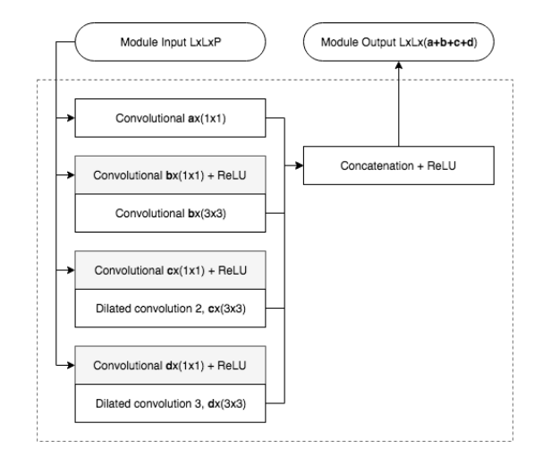
8
Methodologies
MesoInception–4
architecture consists of a series of inception modules with varying receptive fields, allowing for multi-scale feature extraction. These modules are followed by max-pooling layers and dense layers for classification tasks,
uses 3 × 3 depthwise convolutions with the inception module(multiple parallel convolutional pathways of different filter sizes) can be found as a means to deal with multi-scale information
D. Afchar, V. Nozick, J. Yamagishi, and I. Echizen, “Mesonet: a compact facial video forgery detection network,” in 2018 IEEE International Workshop on Information Forensics and Security (WIFS), 2018, pp. 1–7.

Slide 28
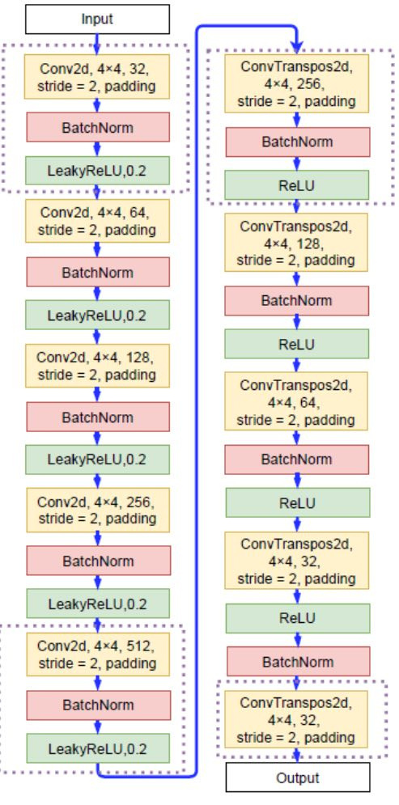
8
Methodologies
Light convolutional neural network(LCNN)
We use CNN for training, Augmented with LFCC Frontend for Feature Extraction and offering a more detailed representation of the linear spectrum, .
It can be observed that the functionality of the proposed genuinization transformer is similar to that of an autoencoder that learns the characteristics of genuine speech.
The output from these layers produces a probability score indicating whether the audio is real or fake.
X. Wang and J. Yamagishi, “A comparative study on recent neural spoofing countermeasures for synthetic speech detection,” arXiv preprint arXiv:2103.11326, 2021.

Slide 29
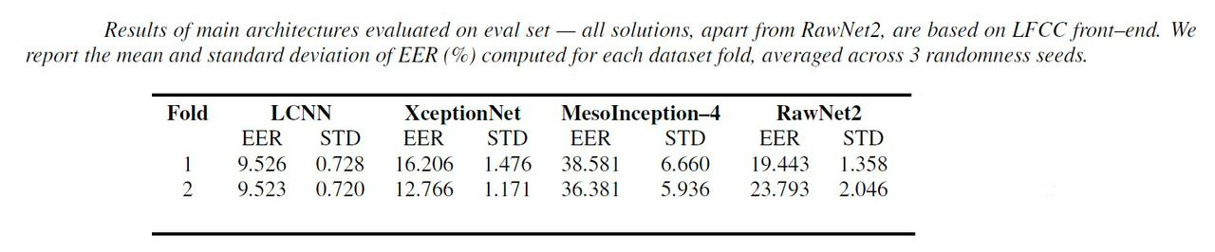
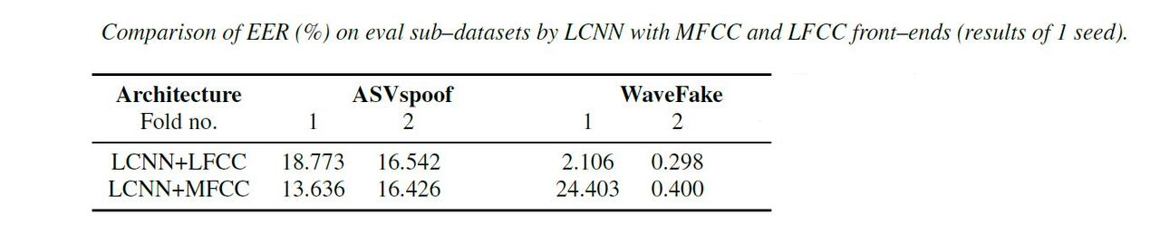

8
Results
Detection

Slide 30
Generationmodel

Slide 31
TEXT-to-speech models

Slide 32
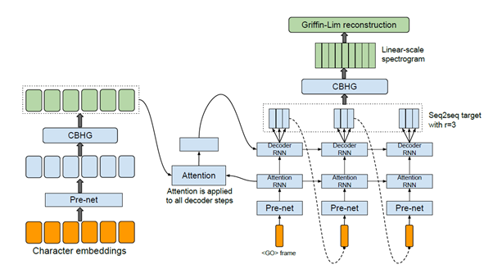
8
Methodologies
Tacotron 1
we introduce Tacotron, an end-to-end generative Text-to-Speech (TTS) model based on the sequence-to-sequence (seq2seq) with attention.
Our model takes characters as input and outputs raw spectogram
Vocoder : Griffin-Lim model
1. CBHG Module :
CBHG consists of a bank of 1-D convolutional filters, followed by highway networks and a bidirectional gated recurrent unit (GRU) recurrent neural net (RNN)
2. Encoder

Slide 33
8
Methodologies
Tacotron 1
3. Decoder:
we use a simply fully-connected output layer to predict the decoder targets
4.Post-Processing :
Use Griffin_Lim as a Vocoder

Slide 34
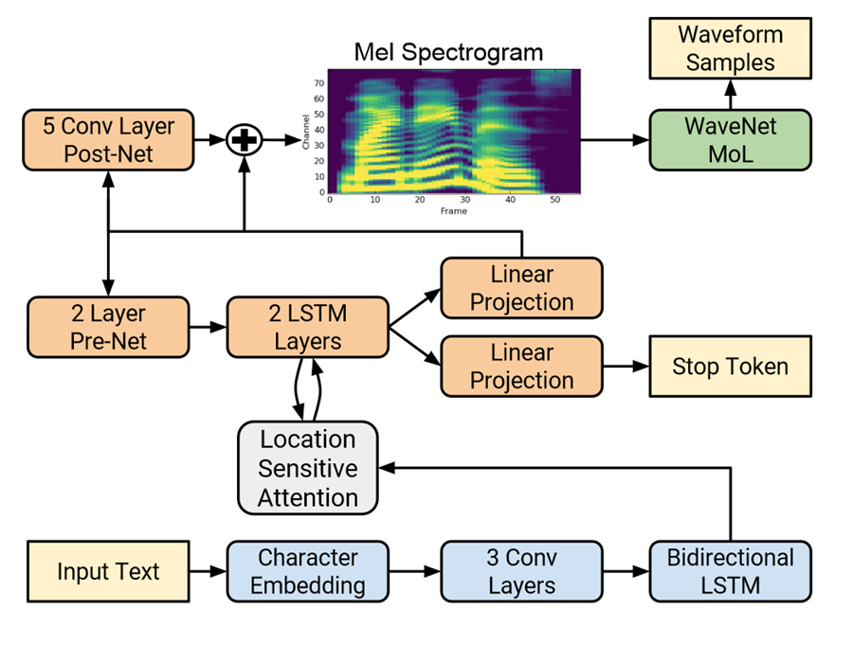
8
Methodologies
Tacotron 2
a neural network architecture for speech synthesis directly from text. The model comprises the following:
a recurrent seq-to-seq prediction network with attention maps character embeddings to Mel-scale spectrograms
Modified version of WaveNet vocoder which generates time-domain waveform samples conditioned on the predicted mel spectrogram frames.
3 Conv layers
Bidirectional LSTM
Shen, J., Pang, R., Weiss, R. J., Schuster, M., Jaitly, N., Yang, Z., Chen, Z., Zhang, Y., Wang, Y., Saurous, R. A., Agiomyrgiannakis, Y., & Wu, Y. (2017). Natural TTS Synthesis by Conditioning WaveNet on Mel Spectrogram Predictions. ArXiv. /abs/1712.05884

Slide 35
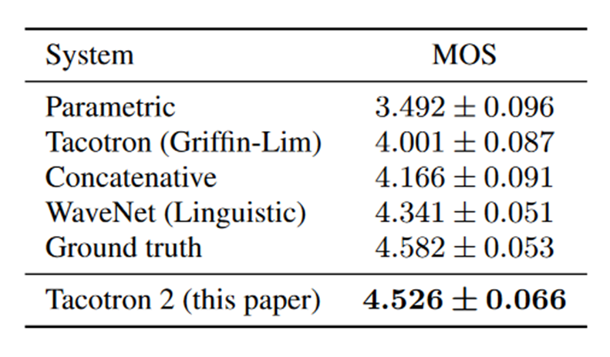
8
Methodologies
Tacotron 2

Slide 36
8
Methodologies
VITS: (Variational Inference with adversarial learning for end-to-end Text-to-Speech)
A conversion model converts the source acoustic features into target acoustic features in the first stage, while a vocoder transforms the converted features into waveform in the second stage.
The two models are usually trained separately.
acoustic feature predicted by conversion model has a different distribution from that the vocoder uses during training
this mismatch problem, can degrade the quality of reconstructed waveform
VITS is a one stage model that can do both TTS and VC. By connecting models of the two stages through latent variables of a conditional variational autoencoder (CVAE), augmented with GAN training
the feature mismatch is reduced
Kim, J., Kong, J., & Son, J. (2021). Conditional Variational Autoencoder with Adversarial Learning for End-to-End Text-to-Speech. ArXiv. /abs/2106.06103

Slide 37
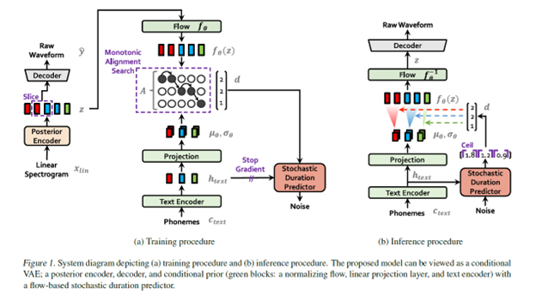
8
Methodologies
VITS

Slide 38
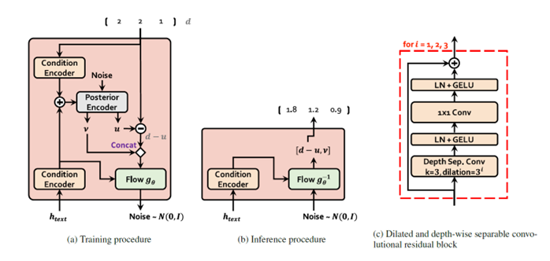
8
Methodologies
VITS
consists of :posterior encoder, prior encoder, each consist of a non-causal WaveNet residual blocks.
encoder, decoder, discriminator (decoder and the multi-period discriminator is the same as the generator and multi-period discriminator of HiFi-GAN), and stochastic duration predictor.

Slide 39
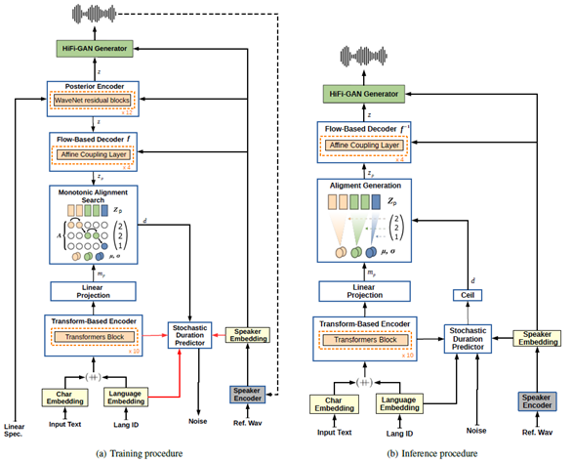
8
Methodologies
YourTTs
Based on the VITS (Variational Inference Text-to-Speech) model.
It builds upon VITS and adds modifications for zero-shot multi-speaker and multilingual training.
​The model uses a transformer-based text encoder, and a HiFi-GAN vocoder. ​
It also incorporates a variational autoencoder (VAE) for efficient end-to-end training and a stochastic duration predictor for generating human-like rhythms of speech.
Casanova, E., Weber, J., Shulby, C., Junior, A. C., Gölge, E., & Ponti, M. A. (2021). YourTTS: Towards Zero-Shot Multi-Speaker TTS and Zero-Shot Voice Conversion for everyone. ArXiv. /abs/2112.02418

Slide 40
8
Methodologies
xTTs
Uses same VITS model architecture.
XTTS is a multilingual Text-To-Speech model, which supports 17 languages (including Arabic).
It can synthesize voice within only 6 seconds.

Slide 41
voice conversion

Slide 42
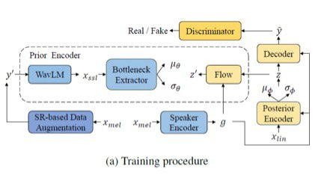
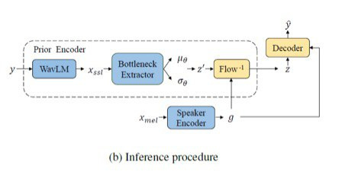
8
Methodologies
FreeVC
It is Based on VITS (Variational Inference Transformer for Speech). ​
for high-quality waveform reconstruction, it adopts end-to-end framework of VITS
The backbone of FreeVC which inherited from VITS is a CVAE augmented with GAN training.
Different from VITS, the prior encoder of FreeVC takes raw waveform as input instead of text annotation.

Slide 43
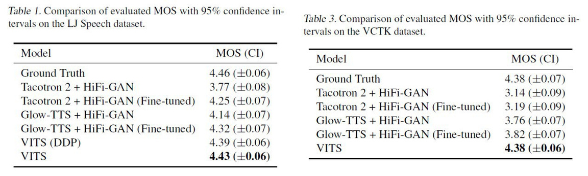
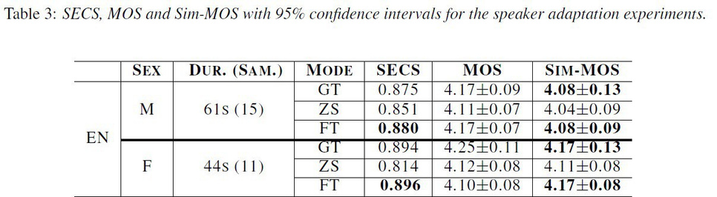
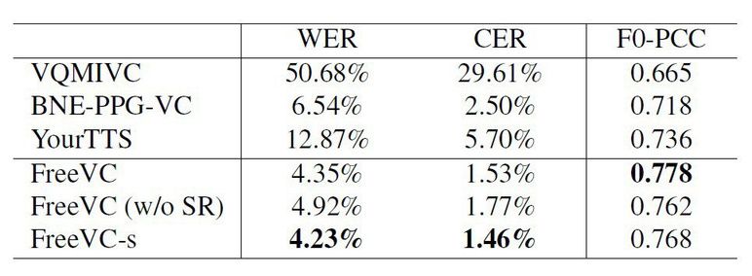
8
Results
Generation
Vits
YourTTS
FreeVc

Slide 44
Filtrationmodel

Slide 45
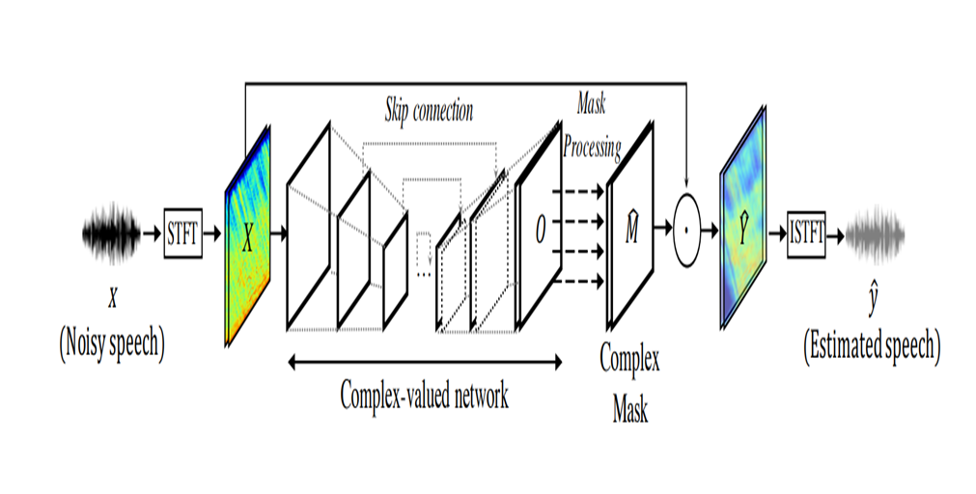
8
Methodologies
DEEP COMPLEX U-NET model
(DCUnet)
combination of complex-valued
building blocks, the U-Net structure,
and skip connections enables DCUnet
to effectively extract features from
complex-valued audio data and
estimate a precise mask for separating
clean speech from noise.

Slide 46
Software
Module

Slide 47

9
Software Module
Main overview
We developed the software to enhance its usability, make it more user-friendly, and provide additional features. Our goal was to create a comprehensive project that meets the needs of our users.

Slide 48
9
Software Module
Why Mobile App?
Accessibility: Allows users to process audio on-the-go,making it more convenient and accessible
Portability: Mobile devices are ubiquitous, ensuring a broader user base
Enhanced User Experience: Mobile apps provide a more interactive experience compared to web applications

Slide 49





9
Software Module
Technology Stack
Android
Kotlin
Firebase
MVVM

Slide 50
9
Software Module
Features
Core Features
Additional Features
Voice Filtration
Deepfake Audio Generation
Fake Audio Detection
History of Audio Activities
User Profile Management

Slide 51
Conclusion

Slide 52
10
Conclusion
Detection
CNN architecture was proved effective after thorough Research and Training
LCNN Model achieved the Lowest EER with 2.370
LCNN with Front-end LFCC provided the best results
GENERATION
Connecting the 2 process stages (acoustic features conversion, and vocoder waveform transformation) via CVAE enhances the quality of reconstructed waveform.
VAE + Hi-Fi GAN Vocoder is a state-of-the-art solution due to voice conversion

Slide 53
10
Conclusion
overall
Overall there is a trade-off between the quality of Deepfake models and the Robustness and Generalization of DFA Detection due to lack of availability of the generated datasets
The trend is moving towards an audio synthesis (SoftVC VITS, ElevenLabs, WebUI, ESPNet,
Voice Engine(OpenAI’s latest))

Slide 54


References
[1] Kawa, P., Plata, M., & Syga, P. (2022). Attack Agnostic Dataset: Towards Generalization and Stabilization of Audio DeepFake Detection. ArXiv. https://doi.org/10.21437/Interspeech.2022-10078
[2] F. Chollet, “Xception: Deep learning with depthwise separable convolutions,” in Proceedings of the IEEE Conference on Computer Vision and Pattern Recognition (CVPR), July 2017.
[3] X. Wang and J. Yamagishi, “A comparative study on recent neural spoofing countermeasures for synthetic speech detection,” arXiv preprint arXiv:2103.11326, 2021.
[4] D. Afchar, V. Nozick, J. Yamagishi, and I. Echizen, “Mesonet: a compact facial video forgery detection network,” in 2018 IEEE International Workshop on Information Forensics and Security (WIFS), 2018, pp. 1–7.
[5] H. Tak, J. Patino, M. Todisco, A. Nautsch, N. Evans, and A. Larcher, “End-to-end anti-spoofing with rawnet2,” ICASSP 2021 - 2021 IEEE International Conference on Acoustics
, Speech and Signal Processing (ICASSP), Jun 2021. [Online]. Available: http://dx.doi.org/10.1109/ICASSP39728.2021.9414234
[6] Shen, J., Pang, R., Weiss, R. J., Schuster, M., Jaitly, N., Yang, Z., Chen, Z., Zhang, Y., Wang, Y., Saurous, R. A., Agiomyrgiannakis, Y., & Wu, Y. (2017). Natural TTS Synthesis by Conditioning WaveNet on
Mel Spectrogram Predictions. ArXiv. /abs/1712.05884
[7] Kong, J., Kim, J., & Bae, J. (2020). HiFi-GAN: Generative Adversarial Networks for Efficient and High Fidelity Speech Synthesis. ArXiv. /abs/2010.05646
[8] Kumar, K., Kumar, R., De Boissiere, T., Gestin, L., Teoh, W. Z., Sotelo, J., De Brebisson, A., Bengio, Y., & Courville, A. (2019). MelGAN: Generative Adversarial Networks for Conditional Waveform Synthesis. ArXiv. /abs/1910.06711
[9] Casanova, E., Weber, J., Shulby, C., Junior, A. C., Gölge, E., & Ponti, M. A. (2021). YourTTS: Towards Zero-Shot Multi-Speaker TTS and Zero-Shot Voice Conversion for everyone. ArXiv. /abs/2112.02418
[10] Kim, J., Kong, J., & Son, J. (2021). Conditional Variational Autoencoder with Adversarial Learning for End-to-End Text-to-Speech. ArXiv. /abs/2106.06103
[11] I. Lapidot and J.-F. Bonastre, “Effects of wavform PMF on antispoofing detection,” in Interspeech 2019, 2019, pp. 2853–2857.
[12] C. Zhang, S. Ranjan, M. K. Nandwana, Q. Zhang, A. Misra, G. Liu, F. Kelly, and J. H. L. Hansen, “Joint information from nonlinar and linear features for spoofing detection: an i-vector based approach,” IEEE International Conference on Acoustics, Speech, and Signal Processing (ICASSP), pp. 5035–5038, 2016.

Slide 55

Thank you

